Slide 1
Miniproject 2: APIs and Data Wrangling
Niklas Bergen
July 30, 2021

Slide 2


Outline
Objectives
Methods Used
Results
Challenges

Slide 3


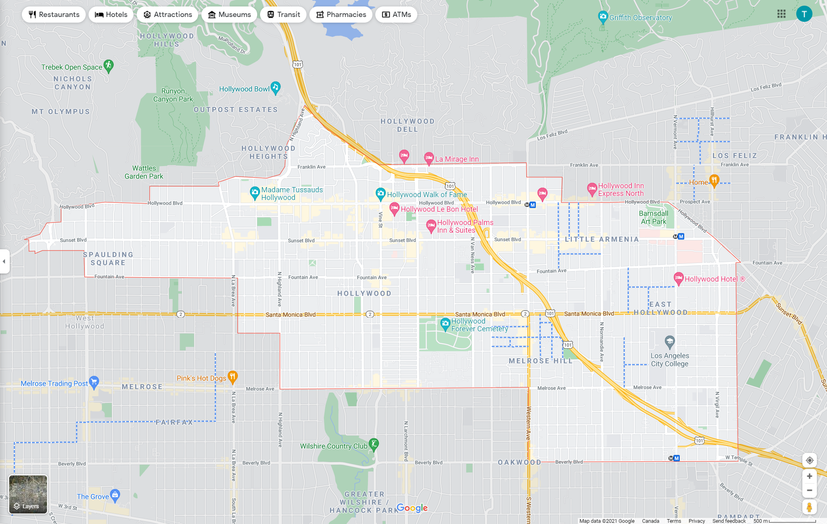

Objectives
Compare yelp & Foursquare APIs
Location:
5 km
Categories: active, arts, shopping
Limit: 50 results
Notes:
Compare yelp & Foursquare APIs functionality and results
Searching for venues located from

Slide 4
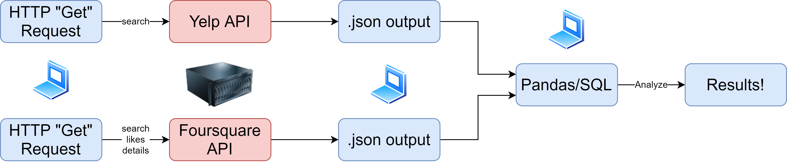
Objectives
Workflow
Notes:
Business search api endpoint
Presentation will focus on pandas, not SQL

Slide 5
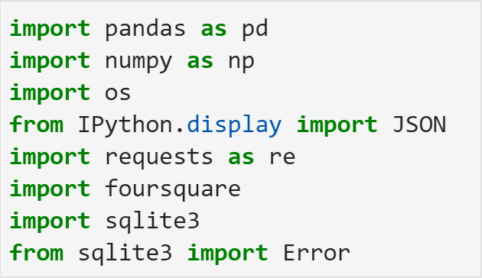

Methods Used
Jupyter Lab
Packages

Slide 6
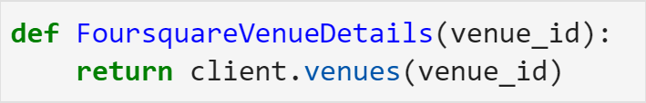
Methods Used
The most useful 3 lines of code:

Slide 7
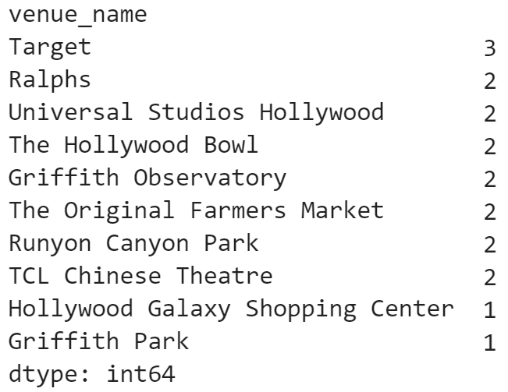

Results
Full query comparison (n = 50 + 46)
Venue Counts
Notes:
- Six common venues (Target and Ralphs were obtained multiple times in Foursquare query).

Slide 8
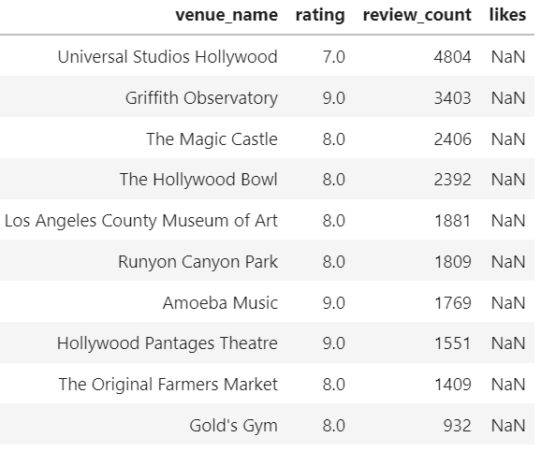
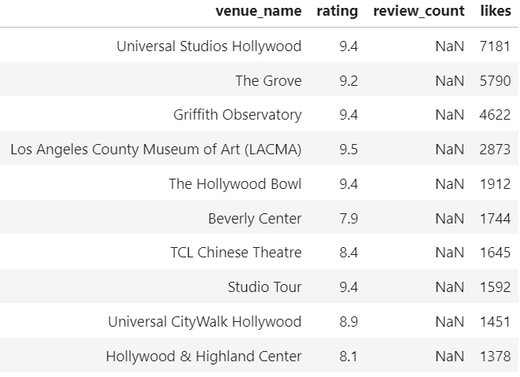
Results
Top 10 comparison (n = 10 + 10)
Notes:
Sorted by review count and likes respectively
Three common venues in top 10
One additional venue is common but has slightly different name
Remaining common venues are not shared in top 10
Key insights: search algorithms return similar results

Slide 9

Results
My favorite API:
More detailed response body
Review-based
Returned full 50 results
5000 Daily API limit, no premium
Notes:
Larger response body for search endpoint
Review-based, harder to game the system compared to likes (see what generates the most buzz)
Returned full 50 results, and no duplicates

Slide 10

Challenges
Manipulating dataframes
Splitting up categories
Watching for typos (API query parameters)
Notes:
If I had more time: setting up charts to compare ratings across platforms in double-bar charts

